Slide 1


Precision SDOH: Addressing Multiple
SDOH Barriers by Chronic Condition
A Presentation by:
Addo Danquah, Richmond
December 6th , 2019

Slide 2

Client Summary
Health Care company providing Insurance and Managed Care services with its headquarters in Clayton, Missouri
Founded in 1984 as Family Hospital Physician Associates and later renamed to Centene in 1997
Currently operates in 32 states with more expansion into the remaining states in 2020 due to its acquisition of WellCare
Largest Medicaid Managed Care Organization in the Country
Largest Long Term Services and Support Provider
More than 15 million Members across the Country
Specific services provided include health insurance market place ( Ambetter), Medicare, Medicaid, Federal services and correctional healthcare
Ranked 51st on Forbes Fortune 500 companies by revenue
Employs more than 51,000 people across the country
$73.6-74.2B in expected revenue for 2019

Slide 3
Methodology
BACKGROUND
Centene understands that, there are important factors beyond health care, although only 10% of the National Health Expenditure is spent on tackling these unmet social needs. With a desire to transforming the health Industry from one of sick care to wellcare, Centene aims to address these unmet social needs affecting people with chronic condition(s) on Medicaid and Medicaid-Medicare Insurance plans.
OBJECTIVE
Identify and address important unmet social needs among the Medicaid and Medicaid-Medicare respondents by chronic condition.
TARGET
People on Medicaid and Dual/ Medicaid-Medicare insurance plan.
TIMING
September 5 – September 12, 2019.
NUMBER OF COMPLETES
Medicaid --255 Medicaid - Diagnosed—137 n=412
Medicaid-Medicare--157 Medicaid-Medicare- Diagnosed--118
METHODOLOGY
Online survey Descriptive analysis Independent Sample T-Test Factor Analysis Cluster Analysis

Slide 4
Terminologies & Abbreviation
SDOH – Social Determinant Of Health
Social Determinant of health are conditions in the environments in which people are born, live, learn, work, play, worship and age that affect a wide range of health, functionality and quality of life outcomes and risks
Unmet Social needs
Inadequate or absence of any of the social determinant of health factors necessary to improve health
Medicaid Insurance Plan
Provides Health Coverage to millions of Americans, including eligible low-income adults, children, pregnant women, elderly adults and people with disabilities. Medicaid is funded jointly by both the State and Federal Government.
Medicare Insurance Plan
This is a federal program which provides coverage for people age 65 and older and also some people under the age 65 who qualify due to disability.
Medicaid-Medicare Insurance Plan/ Dual Plan
This is a dual insurance plan where the enrollee is covered by both Medicaid and Medicare plan. People on this plan are generally low-income seniors, low-income nonelderly individuals with disability or seniors with high medical costs relative to their income
Chronic condition/disease
A condition, illness or disease that is ongoing for at least 3 months
Health Literacy
The ability to obtain, process and understand basic health information to make appropriate health decisions about one’s health and medical care.
Job security
This is an assurance that an individual will keep his or her job without the risk of becoming unemployed.
Food Security
Access to enough food for an active and healthy life
COPD: Chronic Obstructive Pulmonary Disease

Slide 5
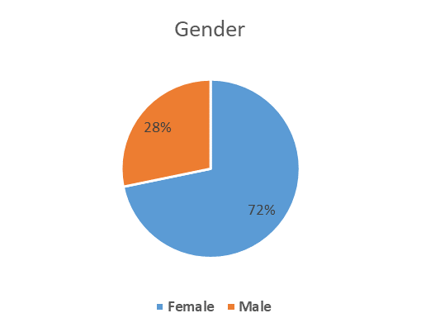
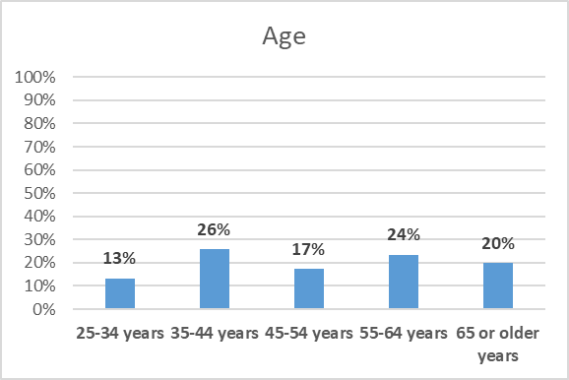
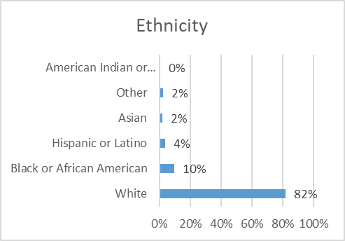
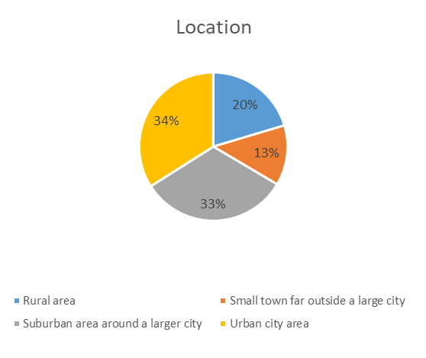
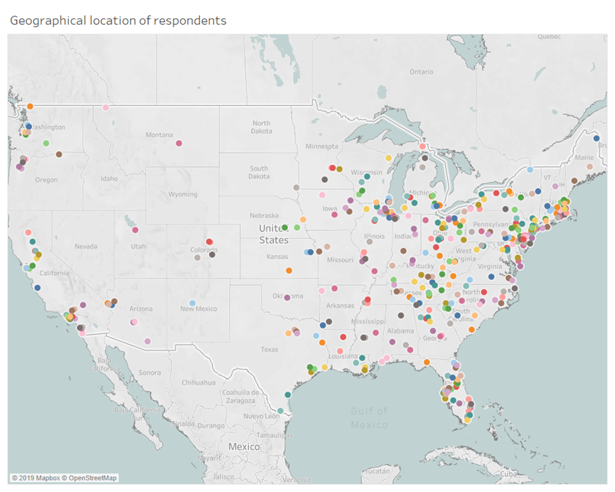
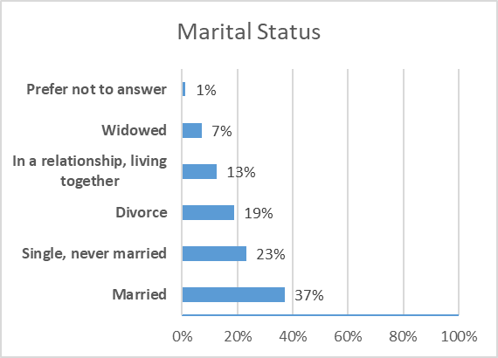
Respondents
n=412
Our respondents demographic features

Slide 6
What SDOH factors are been measured? How do we determine an unmet social need?
Housing Security
Stressed or worried about overcrowding (more people less space).
1
2
Stressed or worried about housing quality (Poor ventilation, water leaks etc.).
3
Stressed or worried about not having enough money to pay rent/mortgage.
4
Stressed or worried about not having enough money to pay utilities.
Job Security
I worry about my job security.
1
Health Literacy
Find it challenging to fill out a medical form by yourself.
1
2
Problem understanding what is told to you by your Doctor about your health condition
Transportation
Had unreliable transportation to attend social, community or religious events.
1
2
Had unreliable transportation to work or school.
3
Had unreliable transportation to medical appointments.
4
Had unreliable transportation to destinations such as shopping, grocery store, the bank, etc.
n=412
What SDOH factors were measured? How do we determine an unmet social need?
Notes:
An unmet social need is determined if a respondent respond with “Always” or “Often” or “Sometimes” to any of the SDOH factor questions.

Slide 7
What SDOH factors are been measured? How do we determine an unmet social need?
Community Safety
Violence (Burglary, guns, gangs etc.)
1
2
Pollution (Sewage, fumes from cars, spills, unclean water, etc.)
3
Cycle of mass incarceration
4
Lack of economic opportunities (eg. Lack of jobs)
5
Drug dealing activities
6
Racial discrimination
Food Security
1
Worried that your food will run out before you get money to buy some
2
Skipped meals because there wasn’t enough money for food
3
Could not afford to eat a balanced or healthy meal
4
Ate less than one should because there wasn’t enough money for food
Social Engagement
1
Felt lonely or isolated from people around me
2
Did not talk to friends or relatives
3
Did not feel content with friendships or relationships
4
Did not have enough people around me that I could ask for help anytime
**Unmet social need = always+often+sometimes
What SDOH factors were measured? How do we determine an unmet social need?
Notes:
An unmet social need is determined if a respondent respond with “Always” or “Often” or “Sometimes” to any of the SDOH factor questions.

Slide 8


Chronic Diseases prevalent among respondents
62%
54%
2.8x
62% of respondents reported being diagnosed with one or more chronic conditions
54% of respondents reported being diagnosed with depression
Women are 2.8x more likely to be diagnosed with depression than men
*Detailed chronic disease breakdown chart in the appendix A
n=412
What are the chronic condition prevalent in the Country?

Slide 9
Chronic Condition by Insurance Plan Type
Medicaid Dual
Depression
N=137
32%
22%
High Blood Pressure
N=112
22%
22%
High Blood Cholesterol
N=91
10%
9%
Asthma
N=83
17%
15%
Diabetes
N=81
15%
16%
Obesity
N=75
12%
17%
N=64
COPD
13%
13%
Heart Disease
N=39
7%
8%
Cancer
N=26
4%
6%
Opioids
N=28
5%
4%
Cerebrovascular Disease
N=17
2%
4%
Alzheimer
N=5
1%
1%
*Detailed chronic disease by insurance plan type breakdown chart in the appendix A
n=412
What are the chronic condition prevalent in the Country?

Slide 10
Unmet Housing Security need- Housing problems
63%
Rodent/pest issues such as bugs
Mold
Water leaks
Structural concern
Smoke detectors not working or missing
No air conditioning
Poor ventilation
Hot water not working
Oven or stove not working
Lead poisoning
No heat
63% of respondents on Medicaid Plan had one or more housing problems
Medicaid (N=137)
2
53%
Dual (N=118)
53% of respondents on Dual Plan had one or more housing problems
*Detailed housing problems by chronic condition can be found in appendix k
n=255
What are the unmet social needs of the respondents with chronic condition(s)?

Slide 11
Unmet Housing Security need- Medicaid vs. Dual with chronic condition(s)
73%
68%
54%
46%
Medicaid
Stressed/worried about paying rent/mortgage due to insufficient funds
Stressed/worried about housing quality
Stressed/worried about overcrowding
Stressed/worried about paying utilities due to insufficient funds
68%
59%
44%
27%
Dual
*Detailed unmet housing security need breakdown chart in the appendix B
n=255
What are the unmet social needs of the respondents with chronic condition(s)?

Slide 12
Unmet Food Security need- Medicaid vs. Dual with chronic condition(s)
66%
55%
56%
54%
Medicaid
Skipped meals because there was not enough money to buy food
Could not afford to eat a balanced or healthy food
Ate less than one should because there was not enough money for food
Worried that your food will run out before you get money to buy some
56%
45%
49%
47%
Dual
*Detailed unmet food security breakdown chart in the appendix D
n=255
What are the unmet social needs of the respondents with chronic condition(s)?

Slide 13
Unmet Food Security need- Respondent with chronic condition.
55%
I do not know if I qualify
There is no Food Pantry or Soup Kitchen in my area
55% of respondents on Medicaid have never or rarely used the Food Pantry or Soup Kitchen to meet their food security needs
Medicaid (N=75)
I am not comfortable because of the stigma attached to it
I do not know where the Food Pantry or Soup Kitchen is located in my area
I do not know the days and times of operations
52%
Dual (N=62)
Others
52% of respondents on Medicaid-Medicare Plan never or rarely use the Food Pantry or Soup Kitchen due to one of the following reasons:
“No way back and forth”
“No transportation”
“Ability to drive there and bring back grocery bags”
“Do not drive”
“Pantry don’t give the kind of food I can eat”
“Not able to carry to the car”
*Detailed unmet food security need breakdown chart in the appendix E
n=137
What are the unmet social needs of the respondents with chronic condition(s)?

Slide 14





Unmet SDOH need
Community Safety
Health Literacy
Reliable Transportation
Social Engagement
Job Security
Unreliable transportation to medical appointments
Respondents living in the urban city are more likely to be concerned about their safety in the community than those in rural area
Challenging to fill out medical form by yourself
Felt lonely or isolated from people around me
78% of respondents with chronic condition(s) have only 1 job
*Detailed breakdown of each SDOH can be found in appendix B,C and D
n=255
What are the unmet social needs of the respondents with chronic condition(s)?

Slide 15


Unmet Social need importance- Respondents with chronic condition(s)
81%
79%
78%
65%
54%
53%
47%
Housing Security
Food Security
Reliable Transportation
Community Safety
Health Literacy
Social Engagement
Job Security
*Detailed unmet social engagement need breakdown chart in the appendix G
n=255
How can the important unmet social needs be addressed?

Slide 16
Social needs rankings by chronic condition
Majority of the respondents with chronic condition(s) consistently ranked Housing security or Food security Reliable transportation as their most pressing social needs.
 | Housing Security | Food Security | Reliable Transportation | Community Safety | Health Literacy | Social Engagement | Job Security
Asthma | 30% | 23% | 36% | 11% | 12% | 8% | 16%
COPD | 34% | 20% | 36% | 14% | 6% | 8% | 12%
Depression | 38% | 29% | 26% | 7% | 5% | 18% | 18%
Diabetes | 35% | 22% | 30% | 15% | 12% | 10% | 11%
Heart Attack | 29% | 19% | 33% | 14% | 9% | 17% | 15%
Obesity | 42% | 28% | 27% | 8% | 11% | 15% | 17%
Opioids | 33% | 16% | 44% | 0% | 15% | 20% | 9%
Cancer | 18% | 26% | 48% | 5% | 6% | 11% | 11%
Alzheimer | 0% | 20% | 40% | 0% | 0% | 25% | 20%
High Blood Pressure | 42% | 24% | 25% | 15% | 7% | 18% | 12%
High Blood Cholesterol | 41% | 26% | 25% | 12% | 6% | 19% | 14%
Cerebrovascular Disease | 25% | 23% | 29% | 8% | 8% | 27% | 12%
N=83
N=64
N=137
N=81
N=39
N=75
N=28
N=26
N=5
N=112
N=91
N=17
Percentages in the table represents respondents who responded with 1 (most pressing need) only. Blue values means the most pressing social need among a specific chronic condition while red is the second most pressing social need
n=255
Rank the following social needs with 1 being the most pressing need and 7 being the least pressing need.
Notes:
Respondents were asked to rank social needs based on how pressing the need(s) are to them on a scale of 1-7. With 1 been the most pressing social need and 7 been the least pressing social need.

Slide 17
Clustering of unmet social need- Diagnosed vs Non-diagnosed
5
Average mean
2
Non-diagnosed
Diagnosed
*Respondent with chronic condition(s) are 2.5x more likely to report unmet housing security, food security, reliable transportation and social engagement need than those without any chronic condition
n=412

Slide 18
Opinions from respondents on how to address their unmet social needs
Housing needs
“We do not have decent low income housing in the city, wish we could get some built or have an organ help with our utilities and help with rent to be able to afford better housing”
“Provide more subsidized senior living facilities in safe areas”
“Provide assistance with relocating out of the area and finding a low income housing unit that will allow Jezebell”
“Make it easier to obtain and keep stable housing and link decent jobs so people can be self supporting”
“Make housing cheaper and food stamps higher”
“I’m on O2 and my light bill is sky high. If I had help with my light bill, I wouldn’t have to worry so much about money”
“I have applied to all organization that will rent me or help me with rent. Short of just going to First Call for help”
“Help with house repairs”
Transportation needs
“Transportation for people who are chronically ill and have to travel over an hour to doctor appointments”
“Supply free transportation to Dr. appts and to volunteer jobs”
“Provide more wide spread public transportation”
“Offer transportation”
“I am at the mercy of others since I’m disabled and can no longer drive myself”
“Maybe vouchers for Uber rides or helping to increase the public transportation in certain areas”
“Clothing and transportation needs”
“Cheaper transportation for disabled people”
Food needs
“More food banks, raise disability income for married couples, give more stamps for 2 people instead of just $110 especially “
“More food banks and those food banks should have healthier options cause a lot of them give folks unhealthy food”
“ Have healthier foods at the food pantries”
“Better Food available in the food banks”
“A working food pantry would be great and be able to qualify for food stamps would certainly help”
n=412
Do you have any suggestion(s) on how an external entity like an organization can help solve your pressing need(s)?
Notes:
Other comments included;
“Church”
“Churches where I can worship the Lord and thank Him for the mini blessings”
“All good”
“A support group for stroke survivors and spouse would help my area”
“Give me money, pay my bills or tell SSA to get their fat butts and give me my disability benefits”
“Christmas gift for kids”
“Government can impose rent control. The prices are out of control high. Apartment renters who tend to be the most financially unstable and poor are paying more than mortgage loan”

Slide 19
Recommendations
Housing Security
Continue the strong partnership between Centene and Habitat for Humanity in building more affordable housing in States Centene has presence.
Food Security
Continue to sponsor programs like Double Up Food Bucks which makes nutritious, locally grown fruits and vegetables more accessible to families in need.
The partnership between Centene and Feeding America for the “Food For Today, Food For Tomorrow” initiative is a step in the right direction and should be continued and expanded in areas that have high food insecurity needs.
Create opportunities for employees to come together to donate Fruits and Vegetables to Food Banks and to the communities.

Slide 20
Recommendations cont.
Reliable Transportation
Ride sharing initiatives aimed at providing members access to transportation to health activities or work activities should be piloted in States Centene has presence.
The Mobile Health Clinic aimed at connecting to members in medically underserved areas should be expanded to other States beyond Georgia.
Ensure strategy is driving toward key areas and delivers on opportunities for enhanced exposure .
The use of www.auntbertha.com or other similar resources would be a great platform and resource to refer members who have unmet social needs to the right resources in their respective communities. Hence all Plans should be encouraged to enroll on this platform and educate members to utilize the platform.

Slide 21
Key Theme & Insights
Depression was found to be the most prevalent chronic condition among the respondents, with higher rates of Depression recorded among the Medicaid respondents than the Medicaid-Medicare respondents. Respondents on Medicaid Insurance Plan tend to have higher unmet needs than respondents on the Medicaid-Medicare Insurance Plan. Irrespective of the respondent’s chronic condition, housing security, food security and reliable transportation were the top 3 most important and pressing social need.
Majority of the respondents with chronic conditions reported been worried or stressed about paying their utilities or rent or mortgage due to insufficient funds.
Respondents with chronic conditions are more worried about their job security than respondents without any chronic condition. Respondents with chronic condition within the age band 25-44 years worry more about their job security than any other age band.
There was a higher unmet need for reliable transportation to medical appointments for respondents on Medicaid insurance Plan while a reliable transportation to destinations such as banks, grocery store, etc. was a major concern for those with Dual Plan
Respondents with chronic condition(s) had a higher need for food security. These respondents were concerned their food will run out before they get money to buy some and could not afford to eat a healthy or balanced meal.
Although there were higher need for food security among respondents with chronic condition(s), more than half of them never or rarely used the Food Pantry or Soup Kitchen to meet their food security needs.

Slide 22
Questions + Discussion.
Thank you

Slide 23
Contacts
Richmond Addo Danquah
Intern, Strategic Insights
Richmond.Danquah@CENTENE.COM
618.514.9448
Teresa Terry
Senior Manager, Strategic Insights
TETERRY@CENTENE.COM
314.349.3741
Britt G. Robertson
Senior Director, Marketing & Communications, G&A
Britton.G.Robertson@CENTENE.COM
314.320.2179
30

Slide 24
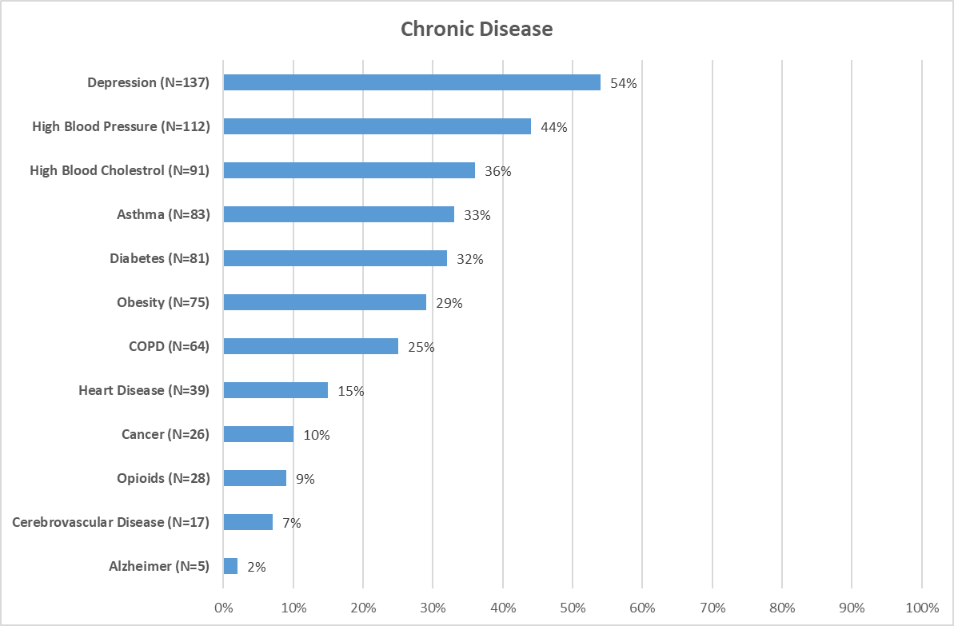
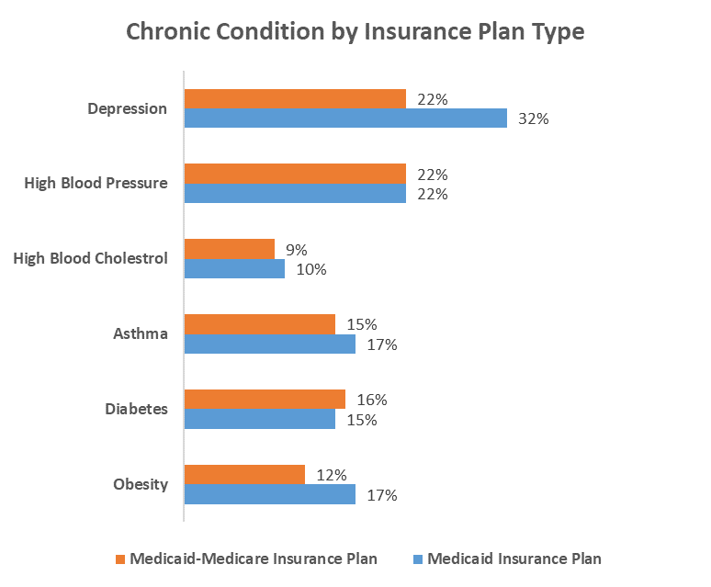
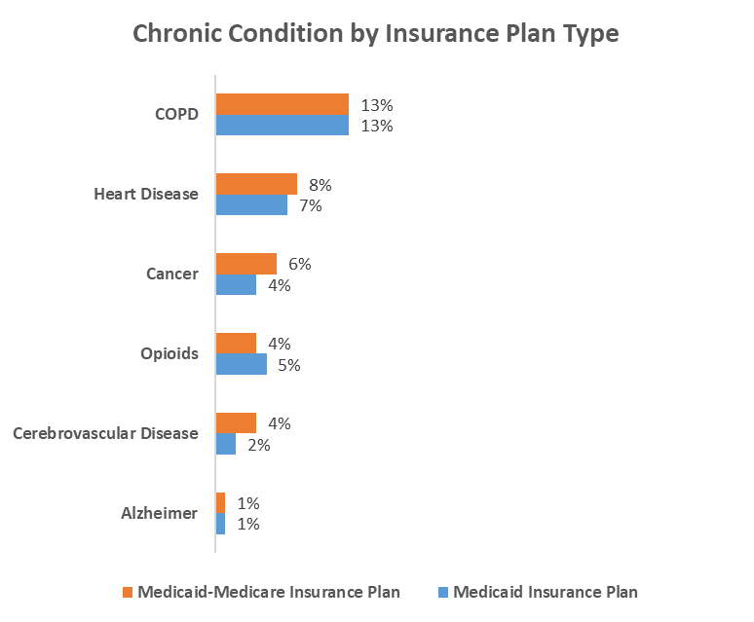
Appendix A

Slide 25
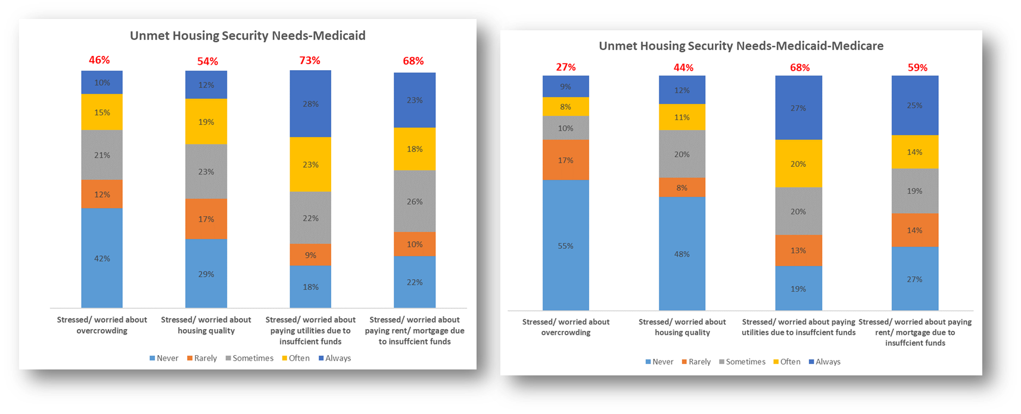
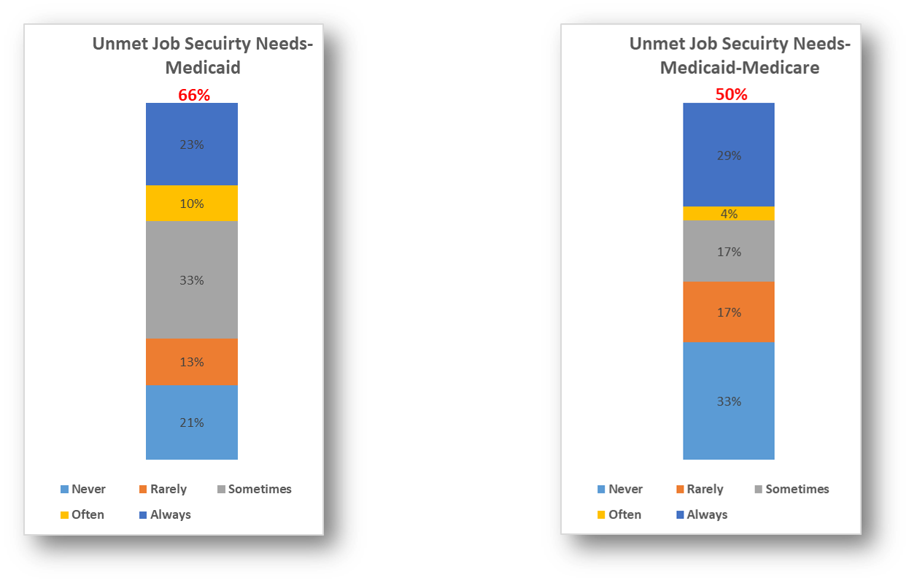
Appendix B
Percentage in red on the top bar combines options sometimes, often and always

Slide 26
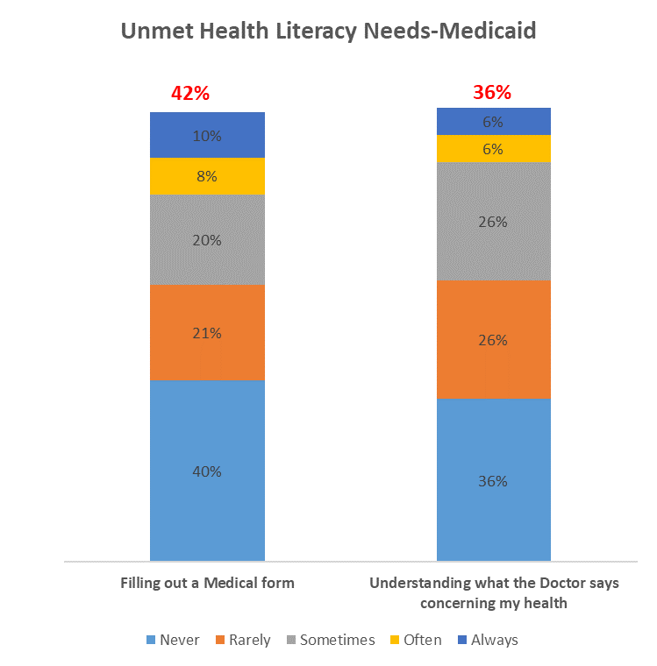
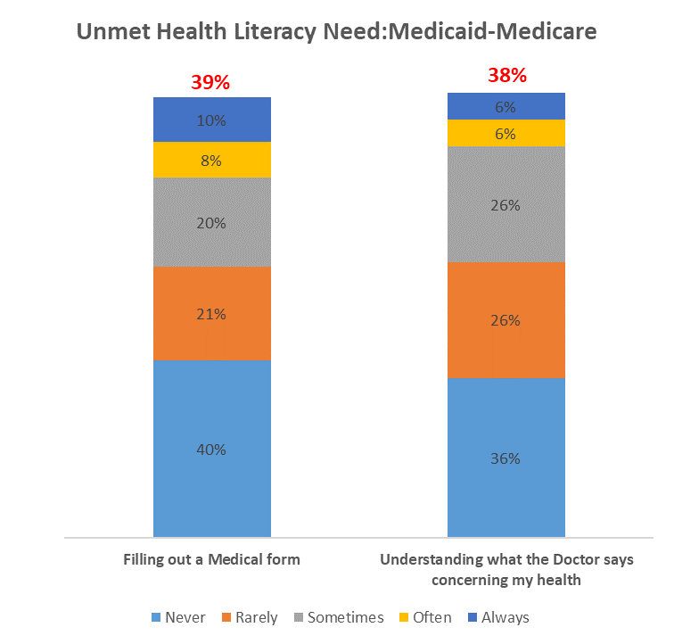
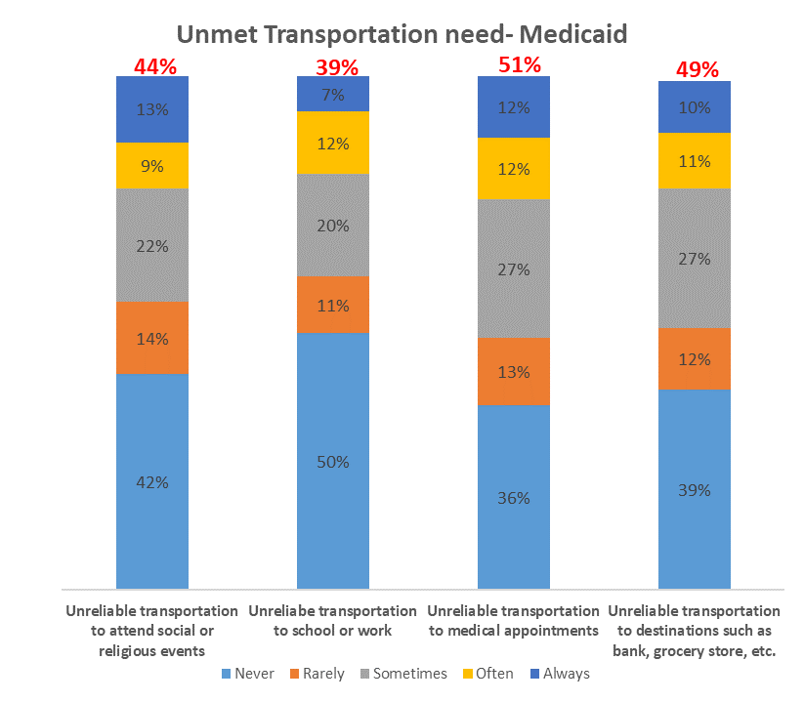
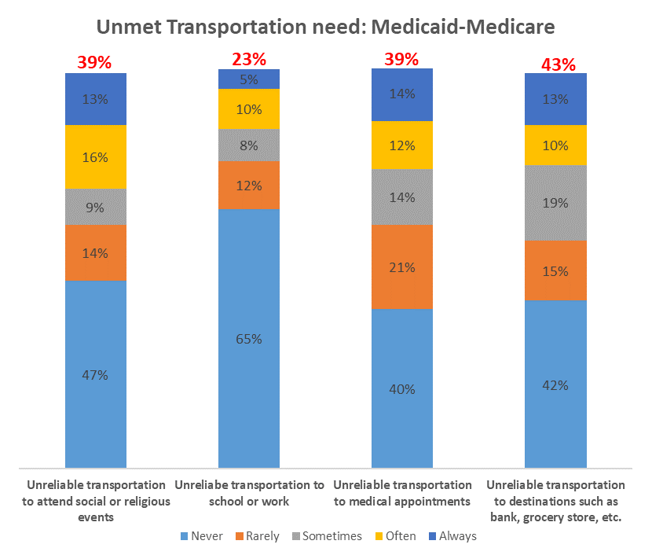
Appendix C
Percentage in red on the top bar combines options sometimes, often and always

Slide 27
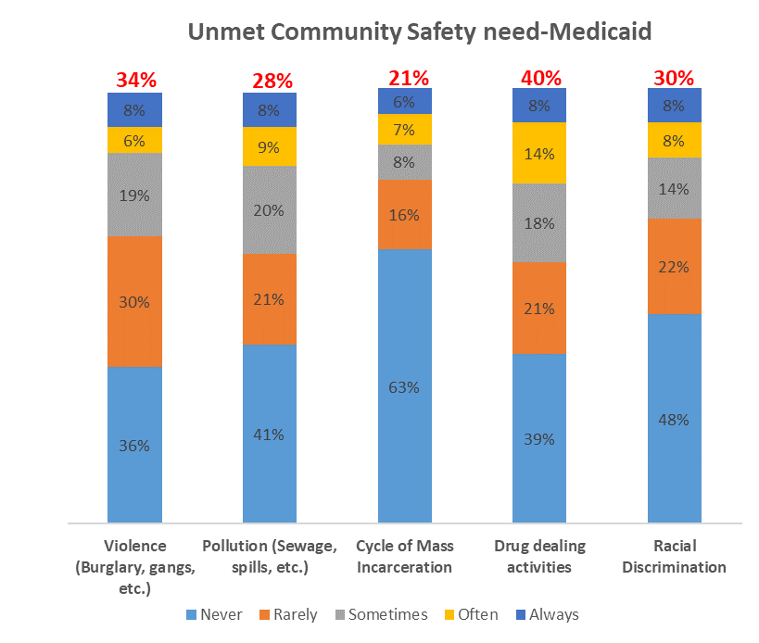
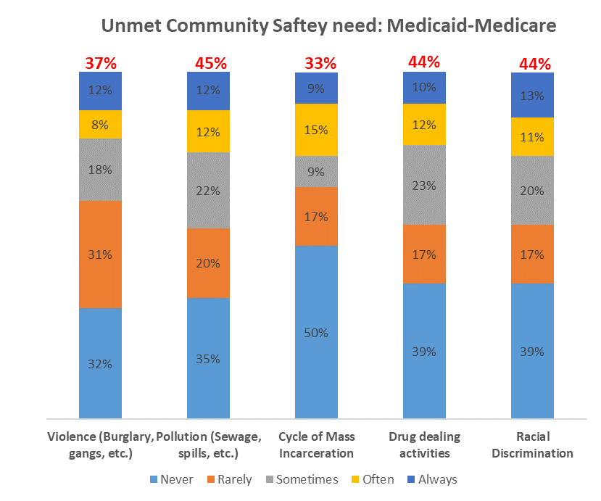
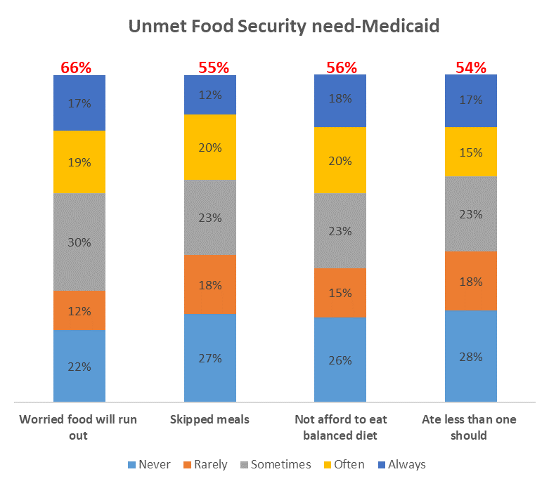
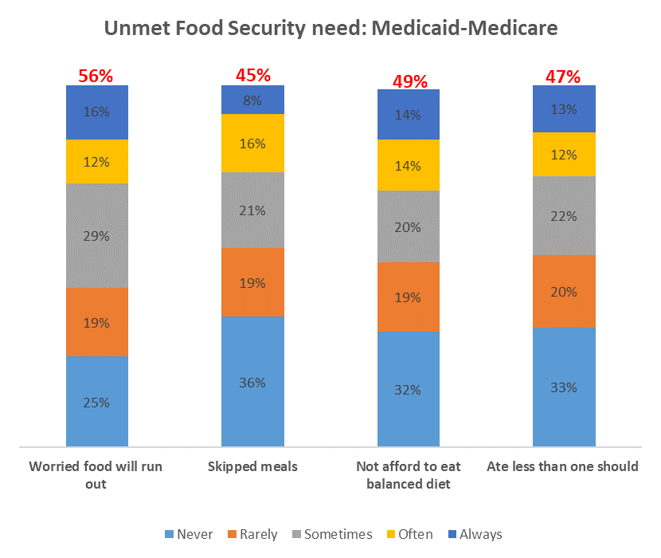
Appendix D
Percentage in red on the top bar combines options sometimes, often and always

Slide 28
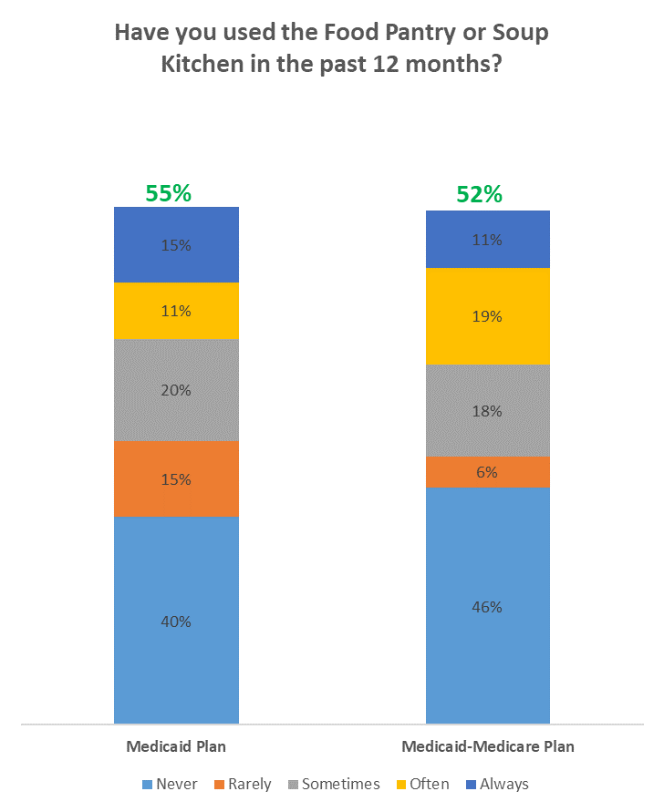
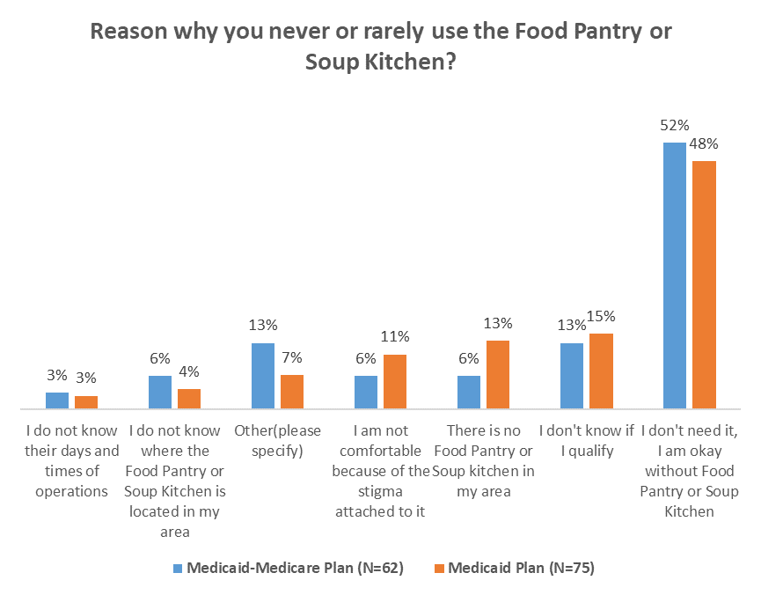
Appendix E
Percentage in green on the top bar combines options never and rarely

Slide 29
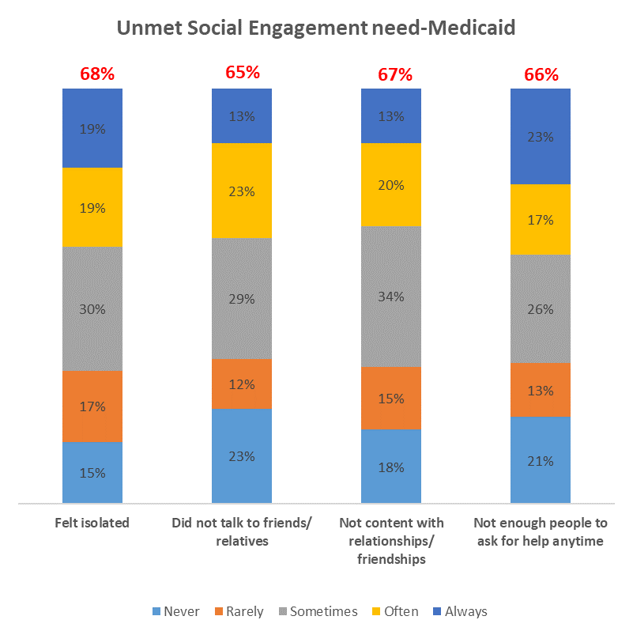
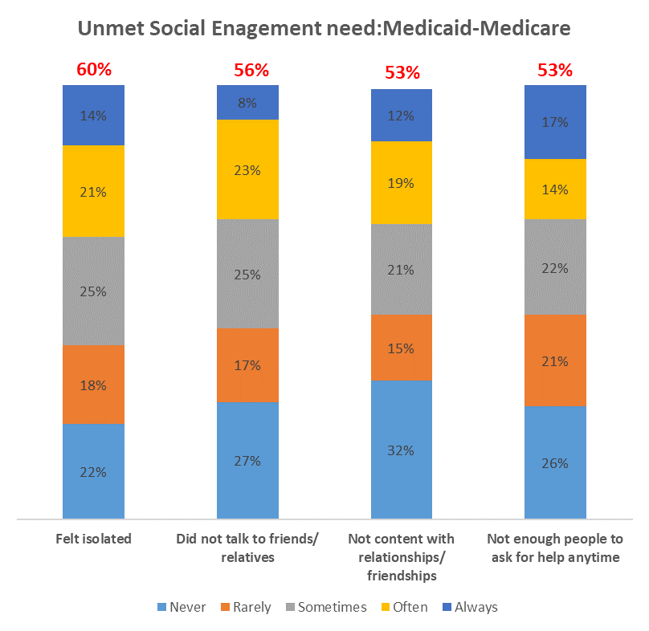
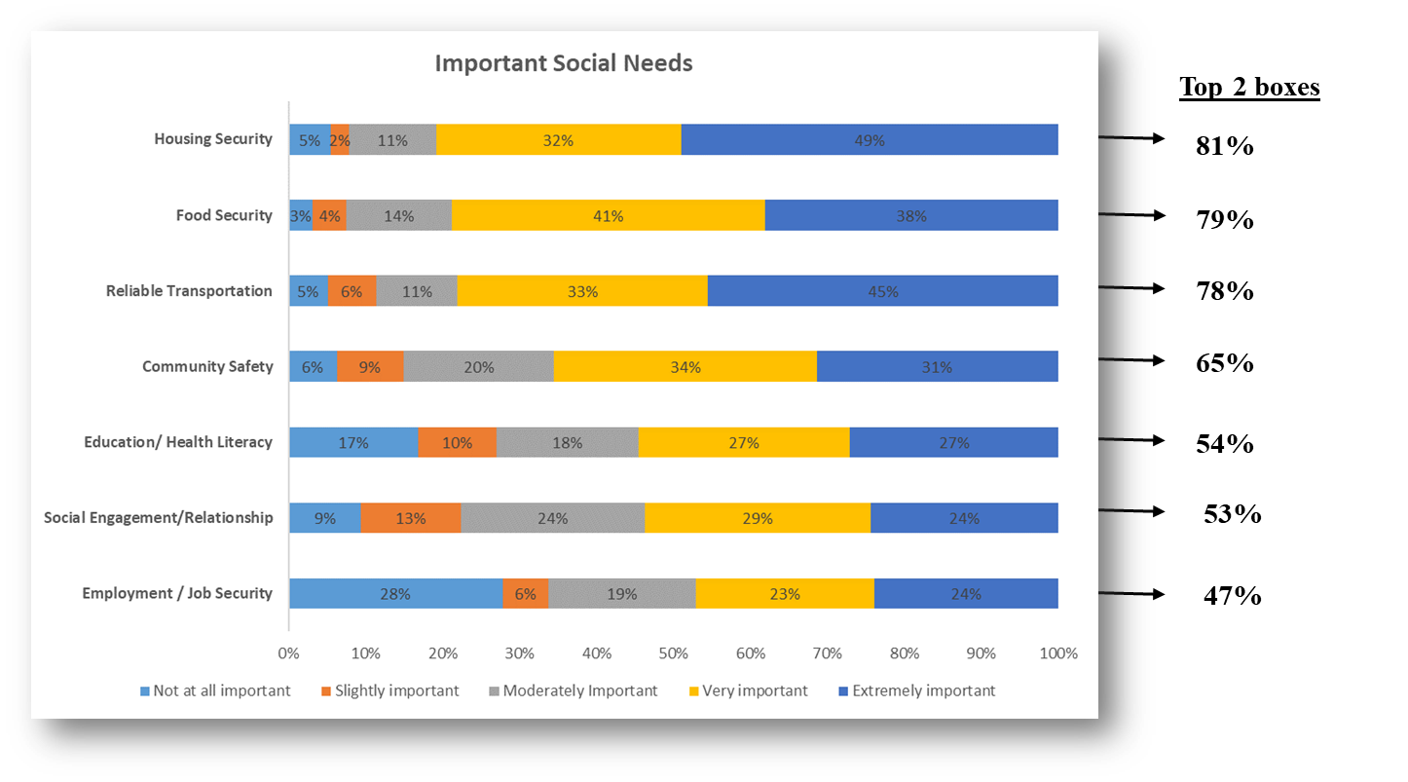
Appendix F
Percentage in red on the top bar combines options sometimes, often and always

Slide 30
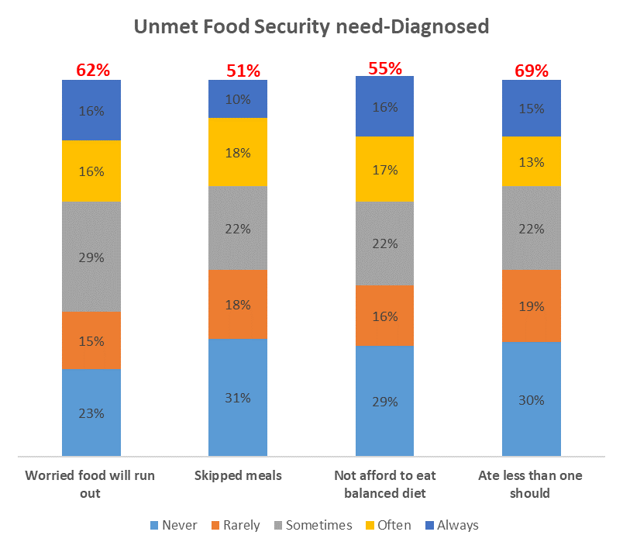
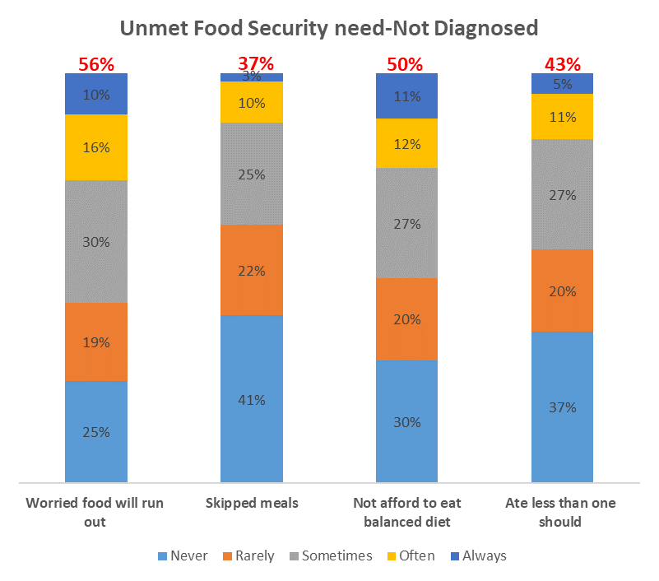
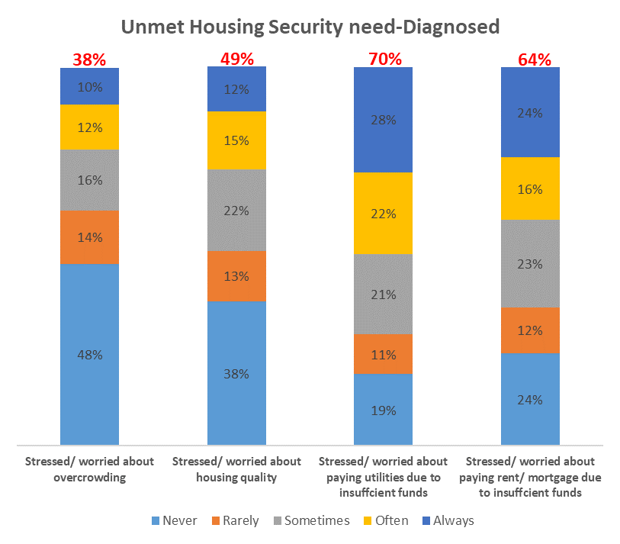
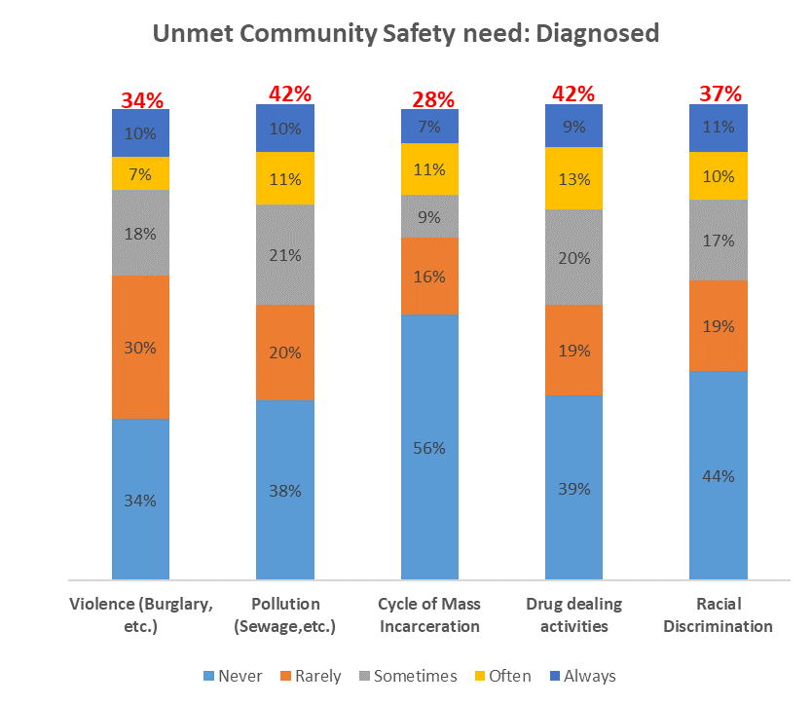
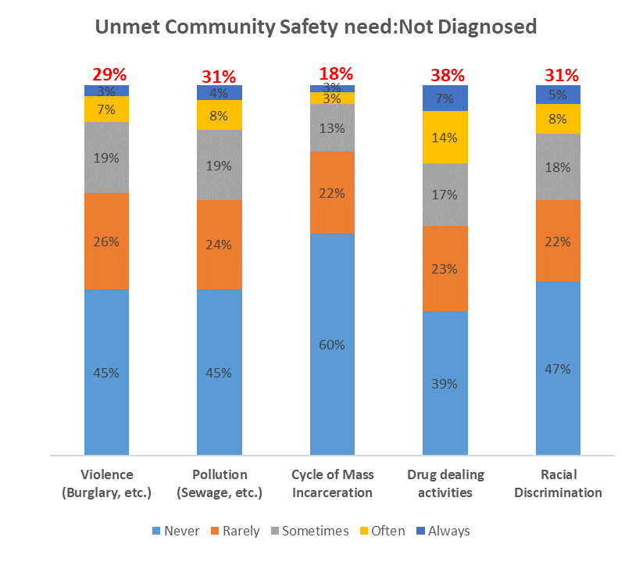
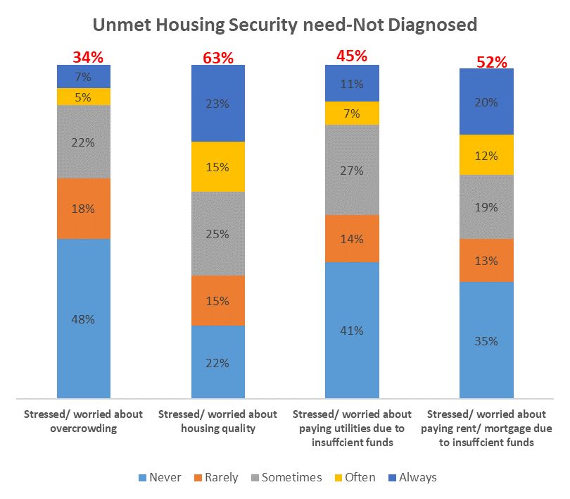
Appendix G
Percentage in red on the top bar combines options sometimes, often and always

Slide 31
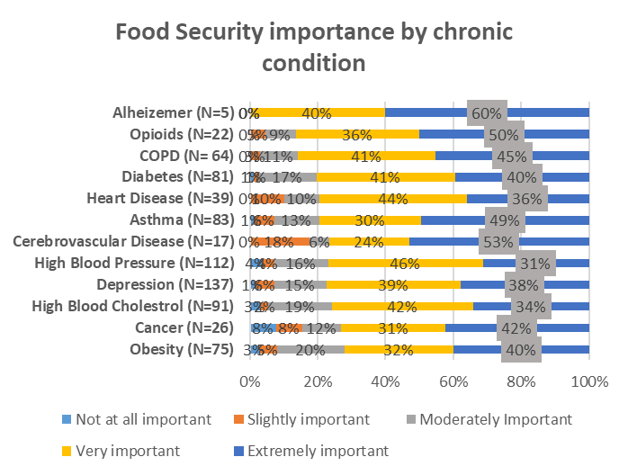
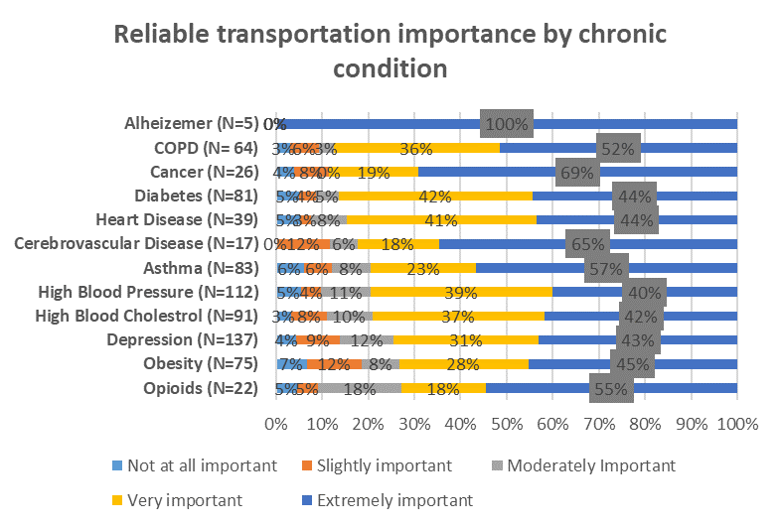
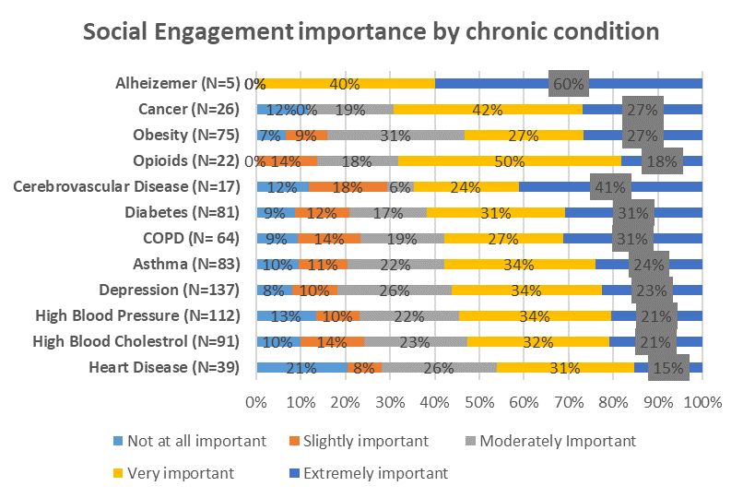
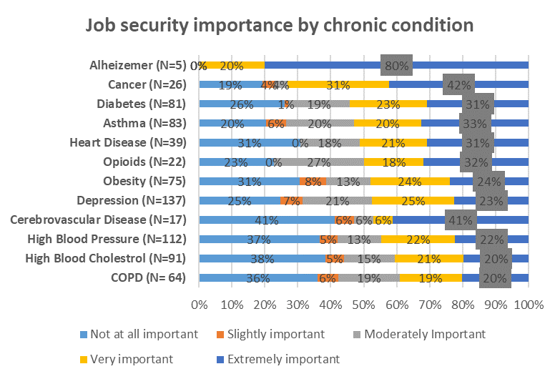
Appendix H
Only the top 2 boxes were used in the report ( very important & extremely important)

Slide 32
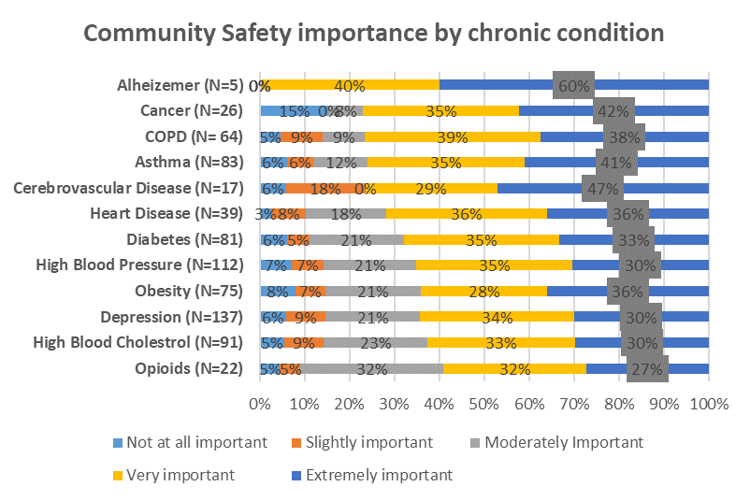
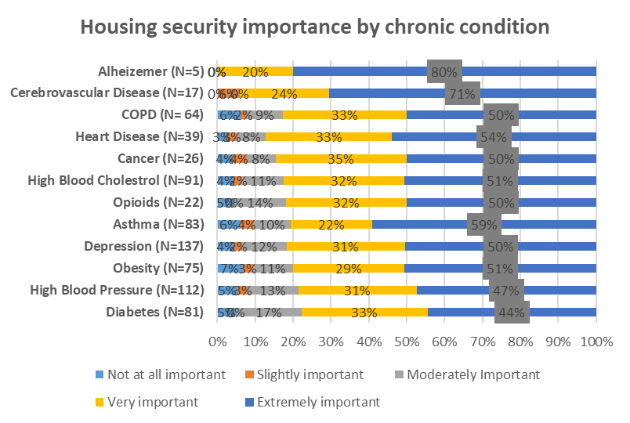
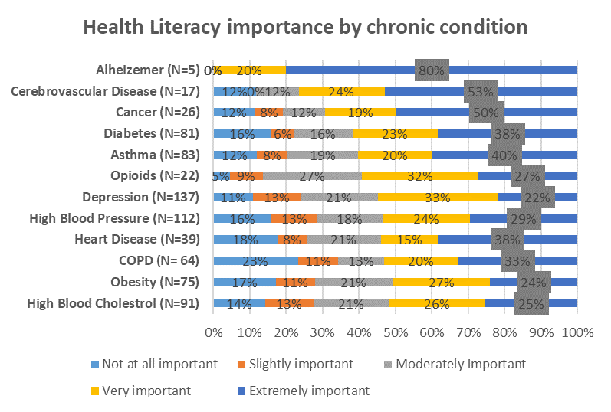
Appendix I
Only the top 2 boxes were used in the report ( very important & extremely important)

Slide 33
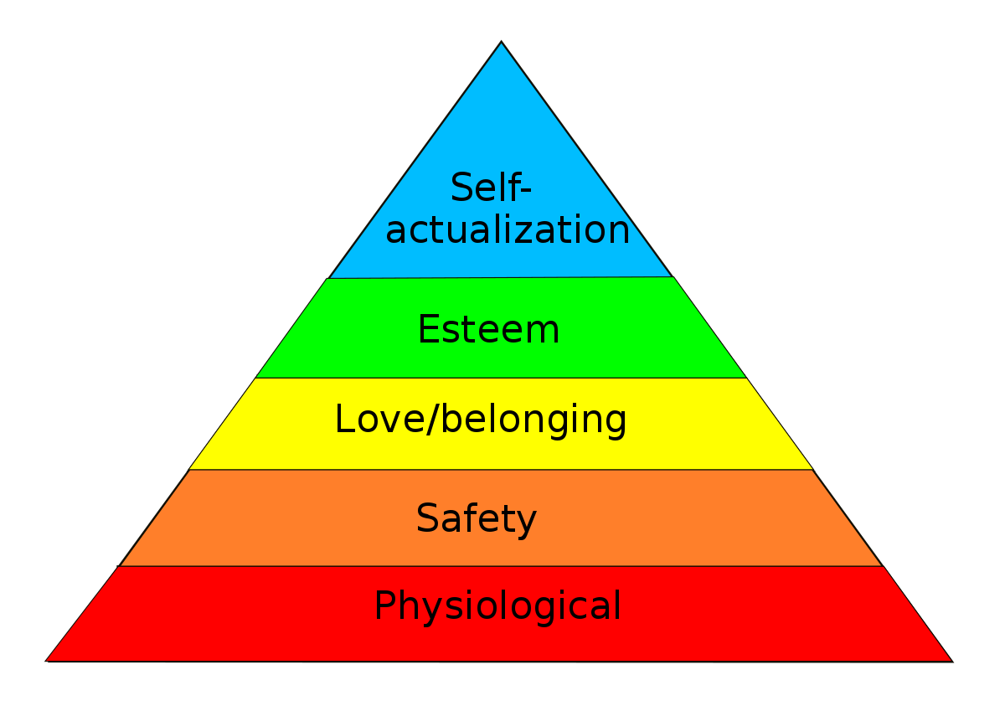
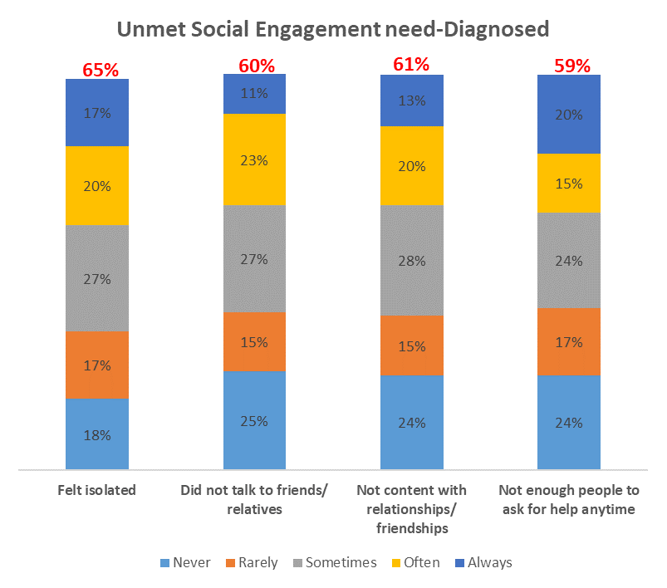
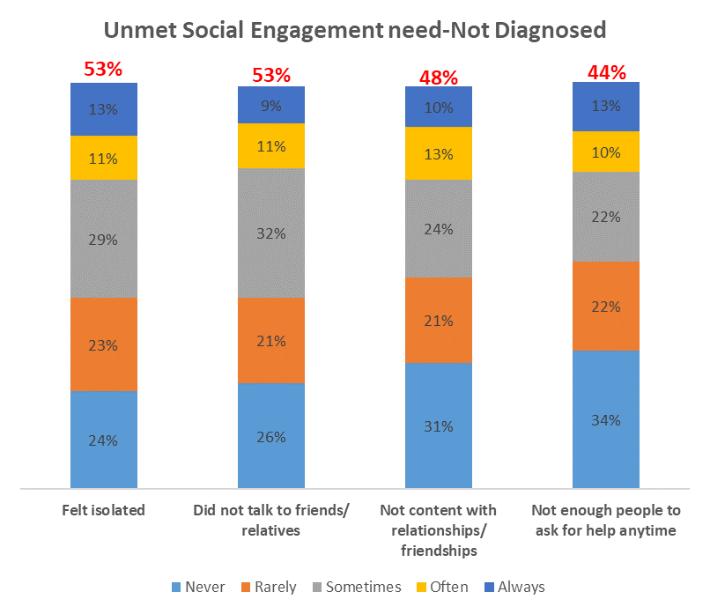
Appendix J
Percentage in red on the top bar combines options sometimes, often and always

Slide 34
Appendix K
 | Rodent/ pest issues | Mold | Water leaks | Structural concerns | Smoke detectors not working | No air-conditioning | Poor Ventilation | Hot water not working | Oven/ stove not working | Lead poisoning | No heat
Asthma | 27% | 27% | 8% | 10% | 14% | 6% | 19% | 7% | 4% | 8% | 2%
COPD | 23% | 14% | 12% | 8% | 14% | 9% | 17% | 6% | 3% | 6% | 2%
Depression | 32% | 25% | 6% | 13% | 15% | 12% | 16% | 7% | 5% | 6% | 4%
Diabetes | 22% | 20% | 19% | 14% | 19% | 12% | 15% | 12% | 4% | 6% | 5%
Heart Disease | 15% | 23% | 13% | 13% | 13% | 10% | 18% | 8% | 5% | 8% | 0%
Obesity | 24% | 31% | 25% | 13% | 8% | 15% | 19% | 7% | 5% | 3% | 4%
Opioids | 25% | 29% | 11% | 14% | 29% | 11% | 25% | 11% | 4% | 11% | 11%
Cancer | 19% | 23% | 8% | 8% | 27% | 4% | 23% | 8% | 4% | 15% | 4%
Alzheimer | 40% | 40% | 20% | 20% | 60% | 0% | 40% | 20% | 0% | 40% | 0%
High Blood Pressure | 24% | 21% | 15% | 13% | 13% | 12% | 14% | 10% | 6% | 4% | 10%
High Blood Cholesterol | 19% | 18% | 12% | 13% | 11% | 11% | 15% | 4% | 4% | 3% | 2%
Cerebrovascular Disease | 29% | 18% | 14% | 12% | 18% | 12% | 29% | 12% | 6% | 18% | 0%
Percentages in bold and colored represents the three top common housing problems across chronic condition. Blue color represents the commonest housing problem with green and red in that order
N=255
Think about where you live. Do you have problems with any of the following by chronic condition? Select all that apply

Slide 35
Appendix L:Social Needs importance by chronic conditions
 | Housing Security | Food Security | Reliable Transportation | Community Safety | Health Literacy | Social Engagement | Job Security
Asthma | 81% | 79% | 79% | 76% | 60% | 58% | 53%
COPD | 83% | 86% | 88% | 77% | 53% | 58% | 39%
Depression | 81% | 77% | 74% | 64% | 55% | 57% | 48%
Diabetes | 77% | 81% | 86% | 68% | 61% | 62% | 54%
Heart Disease | 87% | 81% | 85% | 72% | 53% | 46% | 52%
Obesity | 80% | 72% | 73% | 64% | 51% | 64% | 48%
Opioids | 82% | 86% | 73% | 59% | 59% | 68% | 50%
Cancer | 85% | 73% | 88% | 77% | 69% | 69% | 73%
Alzheimer | 100% | 100% | 100% | 100% | 100% | 100% | 100%
High Blood Pressure | 78% | 77% | 79% | 65% | 53% | 55% | 44%
High Blood Cholesterol | 83% | 76% | 79% | 63% | 51% | 53% | 41%
Cerebrovascular Disease | 95% | 77% | 73% | 76% | 77% | 65% | 47%
N=83
N=64
N=137
N=81
N=39
N=75
N=28
N=26
N=5
N=112
N=91
N=17
Percentages in bold and colored represents the three top common housing problems across chronic condition. Bold black color represents the most important social need with green and red in that order
N=255
How can the important unmet social needs be addressed?

Slide 36
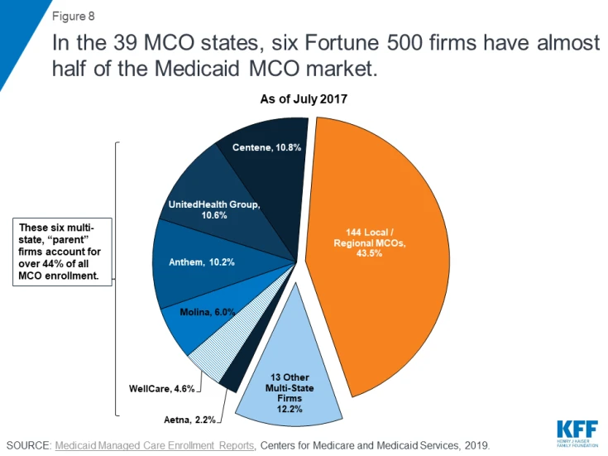

Appendix m

Slide 37
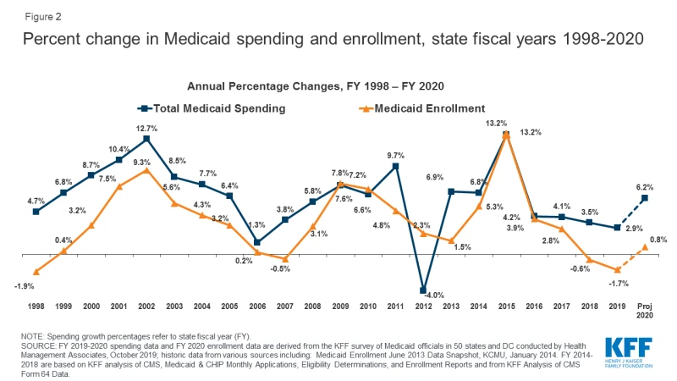
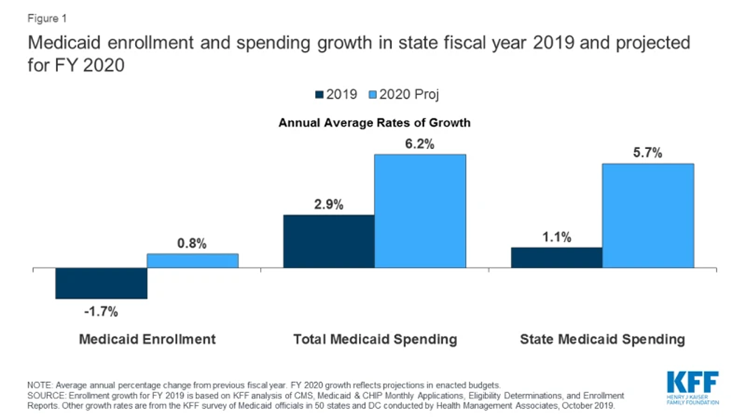
Appendix n

Slide 38
Limitations
Survey Limitation.
Respondents may not feel encouraged to provide accurate and honest answers due to sensitivity of some of the questions.
Respondents may not feel comfortable providing answers that will that presents themselves in an unfavorable manner.
Panel Usage.
This study was limited to only respondents who can read to understand and also have access to the internet.
There may be biased feedback from the respondents because they wished to be continued to be asked to participate in the panel. But these effects are minimal considering the fact that the study relied on Panels from Qualtrics.

Slide 39
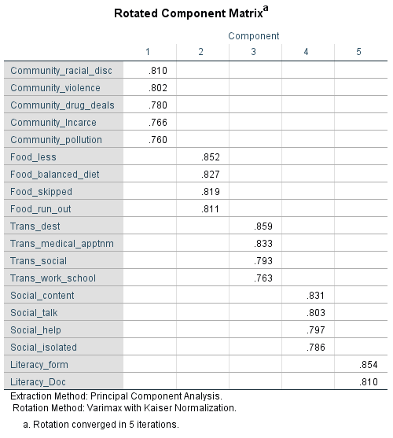
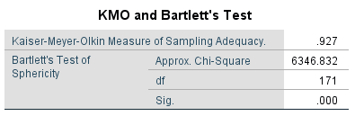
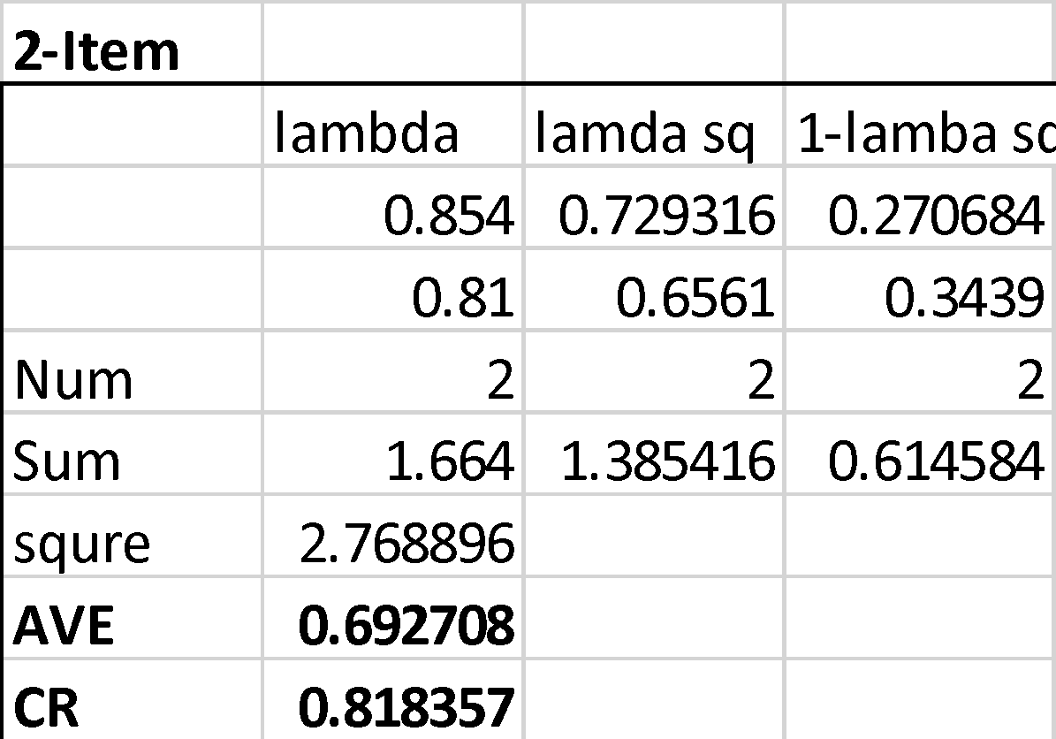
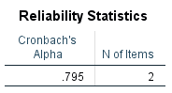
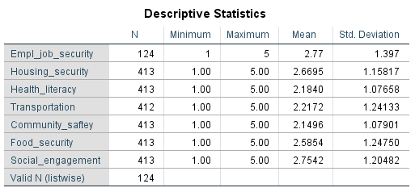
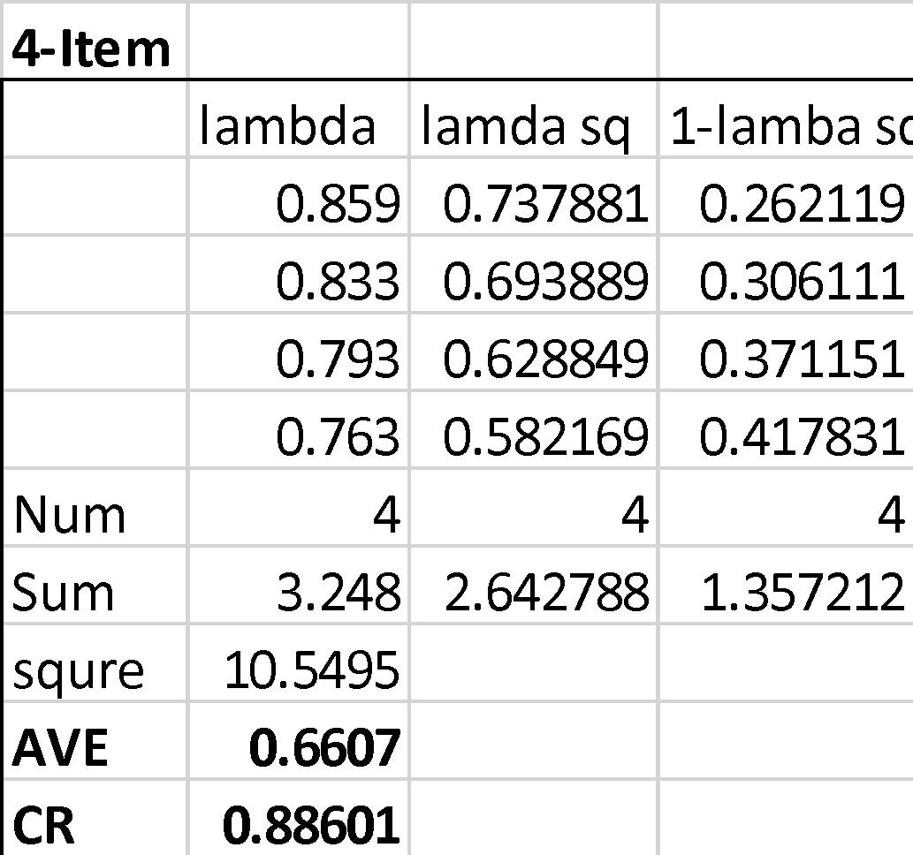

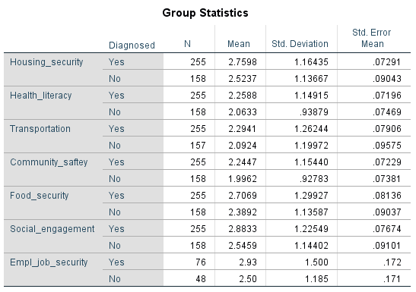









Analysis Appendix1
Health Literacy
Reliable Transportation
Community Safety
Food Safety
Social Engagement
Housing security
NB: A pseudo confirmatory analysis was used to confirm items for Housing Security

Slide 40


Appendix2

Slide 41

Appendix3
Values in the blue oval shape indicates variables that are significant and indicates that there are differences in the needs for the significant variable between diagnosed and non diagnosed respondents

Slide 42





Appendix4

Slide 43

Appendix5

Slide 44

Appendix6

Slide 45







Appendix7

Slide 46
Citations
https://www.ncbi.nlm.nih.gov/pmc/articles/PMC2806885/
2. https://www.acf.hhs.gov/ocs/programs/community-economic-development/healthy-food-financing
3. https://www.ncbi.nlm.nih.gov/pmc/articles/PMC5708005/
4. https://www.healthaffairs.org/doi/10.1377/hlthaff.2017.0999
5. https://www.kff.org/medicaid/issue-brief/medicaid-enrollment-spending-growth-fy-2019-2020/
6. https://www.kff.org/medicaid/issue-brief/10-things-to-know-about-medicaid-managed-care/
5. Centene.com
6. Unitedhealthcare.com
7. Anthem.com

Slide 47
Citations
8. An Empirical Study of Chronic Diseases in the United States: A Visual Analytics Approach to Public Health by Wullianalur Raghupathi and Viju Raghupati
9. U.S. Department of Health and Human Services . Multiple Chronic Conditions—A Strategic Framework: Optimum Health and Quality of Life for Individuals with Multiple Chronic Conditions. U.S. Department of Health and Human Services; Washington, DC, USA: 2010
10. https://www.guidestone.org//media/Insurance/WorksiteWellness/CostOfChronicDiseaseAndObesity.pdf?la=en.
11. Fried L. America’s Health and Health Care Depend on Preventing Chronic Disease.
6. https://www.cdc.gov/chronicdisease/resources/infographic/chronic-diseases.htm

